Slide 1
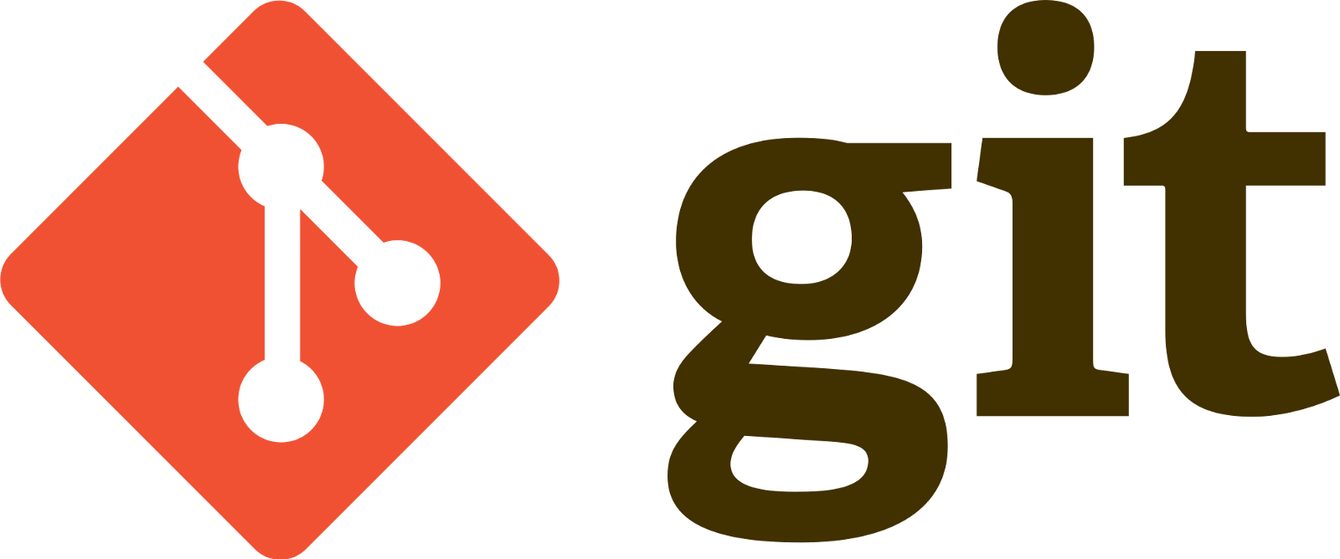
A Version Control System (VCS)

Slide 2
What is it?
A repository for developers
Version Control System
Open source platform
Created by Linus Torvalds in 2005
Git vs other VCS.

Slide 3
Terminology
Repository | The collection of all the code in a top folder
Branch | A development line away from the production line
Tag | A user-defined reference to a commit. E.g. v1.0.0
Stage | All changed files that have been added and ready to commit.
Commit | Saving the staged files at a point in time.
Origin / Remote | The remote repository.
Workflow | The transition between branches, a release method.
Pull/Merge Request | Used for restricted branches requiring peer review.

Slide 4
Deep Dive
Create Repository | Git init <name>
Clone Repository | Git clone <repo address>
Check out Branch | Git checkout <branch_name>
Stage files | Git add <filename>
commit | Git commit -m “Message”
Push to Origin | Git push
Pull changes from origin | Git pull
Get updates about origin | Git fetch
Get status of current branch | Git status
Tag a commit | Git tag <tag> <commit_id>
History of Git changes | Git log

Slide 5
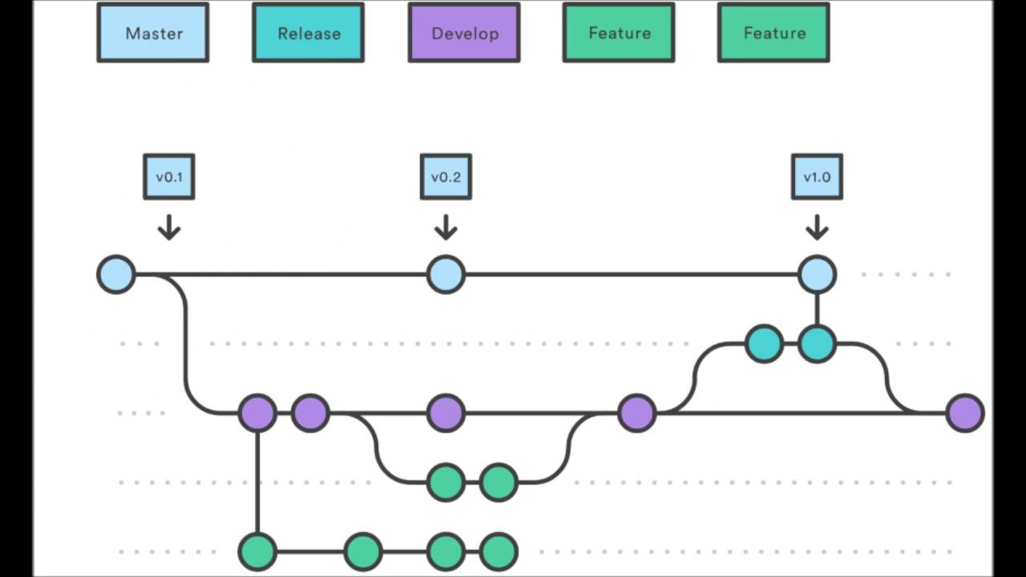
An example workflow
Tag
Branch
Commit

Slide 6
Lets Get started
Github (Cloud Hosted Repository) | https://github.com/
Git | https://git-scm.com/
Tortoise Git | https://tortoisegit.org/
Create account on Github
Clone Repository https://github.com/laywah2016/GitDemo.git
Start Committing

